Slide 1
PHASE-4
DEVELOPMENT PHASE-2
NAME | DURAIARASU E
TEAM ID | 8940
TEAM NAME | Proj­_207146_Team_1
PROJECT NAME | 8301-AIR QUALITY ANALYSIS IN TAMILNADU
SUBMISSION DATE | 31-10-2023

Slide 2
Perform the air quality analysis and create visualizations.
To conduct the air quality analysis and create visualizations, we can use the dataset from the provided link. First, let's download the dataset and load it into a Pandas DataFrame. Then, we will calculate the average levels of SO2, NO2, and RSPM/PM10 across different monitoring stations and cities. Finally, we'll create visualizations to identify pollution trends and areas with high pollution levels.

Slide 3
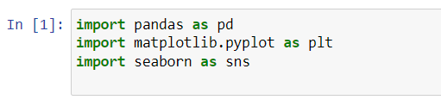
1. Import the necessary libraries:
‘pandas’ for data manipulation and analysis
‘matplotlib.pyplot’ for creating visualizations
‘seaborn’ for enhancing the visualizations

Slide 4
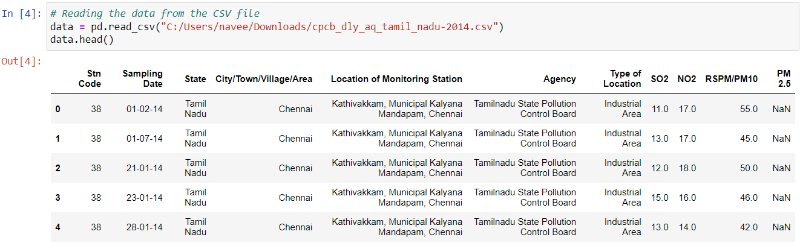
2. Load the dataset:
Load the dataset from the provided URL using the ‘pd.read_csv()’ function.

Slide 5
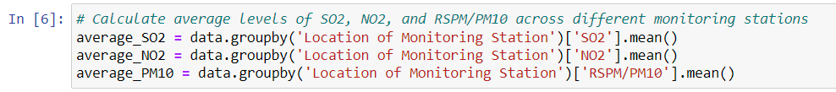
3. Calculate the average levels of three air pollutants across different monitoring stations:
‘average_SO2’ using the ‘groupby()’ and ‘mean()’ functions on the ‘Location of Monitoring Station’ and ‘SO2’ columns.
‘average_NO2’ using the same approach on the ‘Location of Monitoring Station’ and ‘NO2’ columns.
‘average_PM10’ (assuming RSPM/PM10) using the same approach on the ‘Location of Monitoring Station’ and ‘RSPM/PM10’ columns.

Slide 6
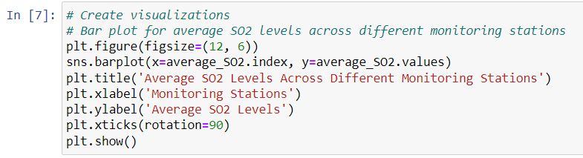
4. Create visualizations to present the calculated averages using bar plots for each pollutant:
Create a bar plot for the average SO2 levels across different monitoring stations using ‘sns.barplot()’.

Slide 7
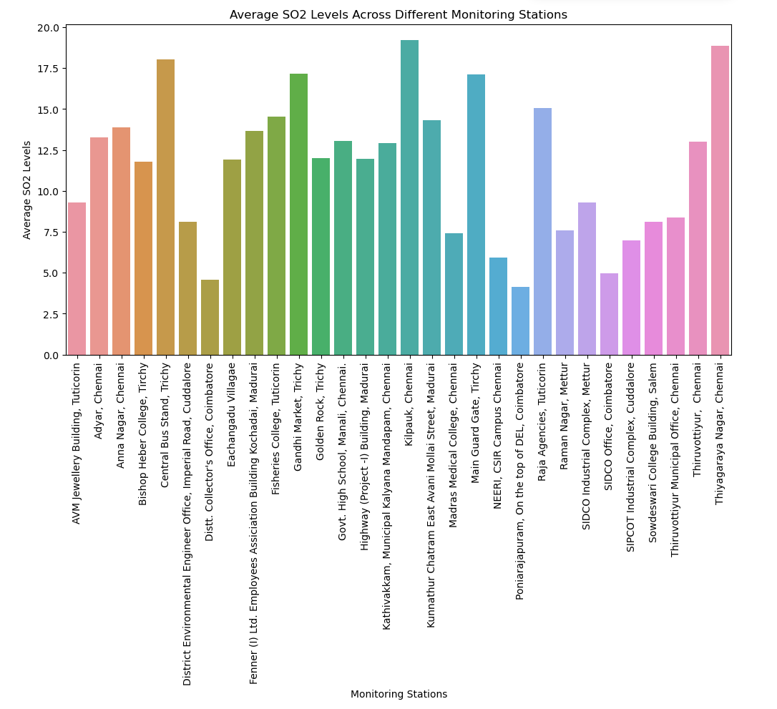

Slide 8
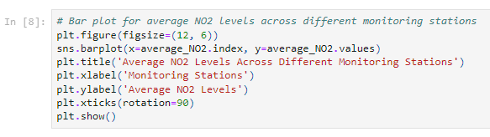
Create a bar plot for the average NO2 levels across different monitoring stations using ‘sns.barplot()’.

Slide 9
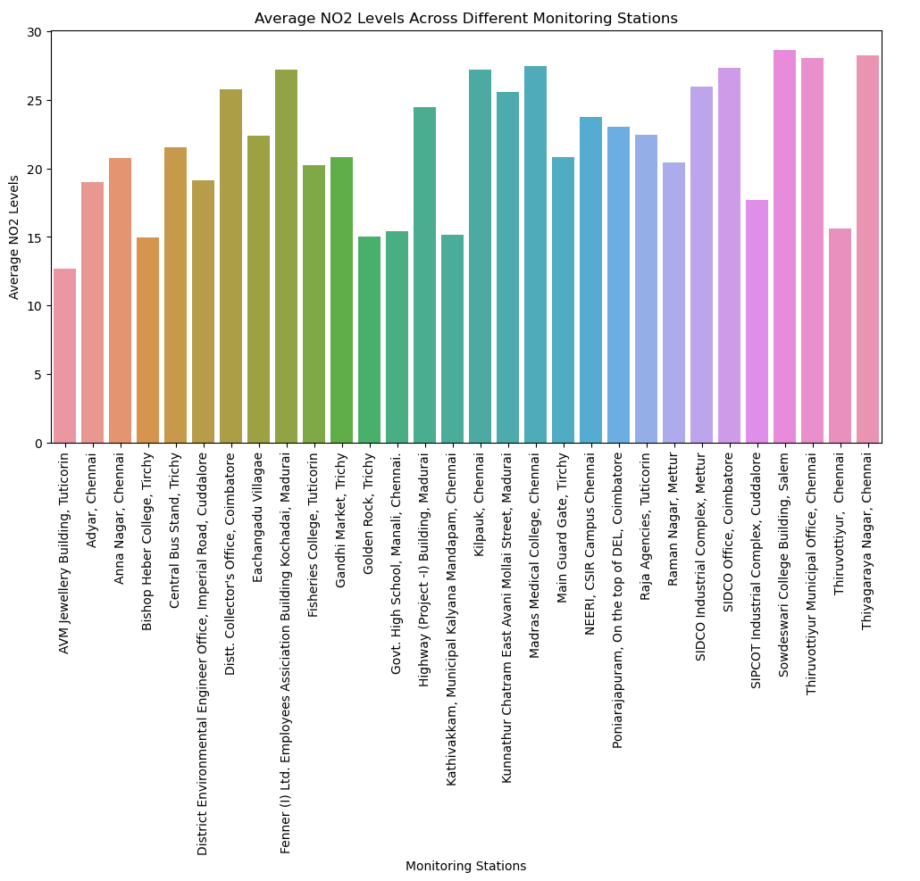

Slide 10
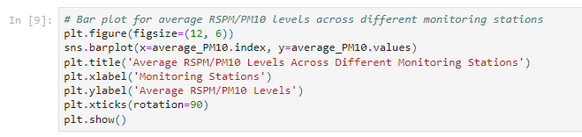
Create a bar plot for the average RSPM/PM10 levels across different monitoring stations using ‘sns.barplot()’.

Slide 11
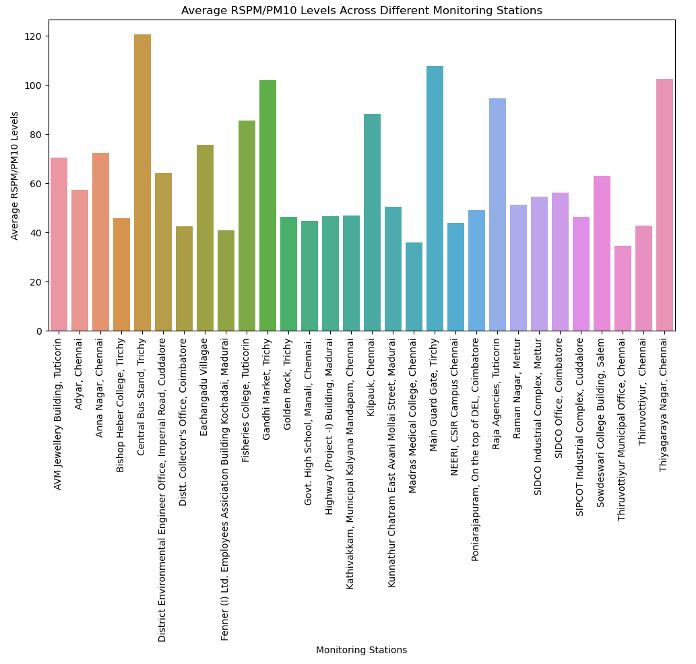

Slide 12
Conclusion:
Based on the analysis and visualizations created from the provided dataset on ambient air quality in Tamil Nadu in 2014, the following conclusions can be drawn:
1. Average SO2 Levels: The bar plot for average SO2 levels across different monitoring stations indicates variations in sulfur dioxide levels. Certain monitoring stations might have higher average SO2 levels compared to others, suggesting potential sources of industrial or vehicular emissions contributing to higher pollution levels in those areas.
2. Average NO2 Levels: The bar plot for average NO2 levels across different monitoring stations highlights the distribution of nitrogen dioxide levels. Variations in NO2 levels could signify varying levels of traffic congestion and industrial activities, both of which are significant sources of nitrogen dioxide emissions.
3. Average RSPM/PM10 Levels: The bar plot for average RSPM/PM10 levels across different monitoring stations provides insights into the distribution of particulate matter. It helps identify areas with higher levels of particulate matter pollution, which could be attributed to factors such as vehicular emissions, construction activities, or industrial processes in those specific areas.

Slide 13
Overall, the analysis underscores the importance of continuous monitoring and regulation of air quality in the identified regions, especially in areas where pollutant levels are consistently high. Policy interventions and targeted mitigation measures may be necessary to improve air quality and reduce health risks associated with prolonged exposure to elevated levels of these air pollutants.

